Slide 1
BREAKFAST | SUNDAY | MONDAY | TUESDAY | WEDNESDAY | THURSDAY | FRIDAY | SATURDAY
OPTION 1 | Continental Breakfast served in the Boarding Houses | American Pancakes, Berry Compote, Vanilla Yoghurt, Maple Syrup (V) | Local Butcher’s Chicken Sausage, Fried Egg, Baked Beans | Danish Bacon, Grilled Tomatoes, Fresh Spinach | Soya & Onion Sausage (V) | 'Build a Bagel' Danish Bacon, Poached Egg, Spinach | 'The Denstone Wrap’ Cheese, Sliced Tomato, Hash Brown Tots (V)
OPTION 2 |  | Danish Bacon, American Pancakes, Scrambled Egg | Toasted Cheese Rarebit-topped Sourdough (contains egg) (V) | Mini Omelette served with Fresh Spinach (V) | Local Butcher’s Pork Sausage, Sautéed Mushrooms, Hash Brown, Baked Beans | 'Build a Bagel' Smashed Avocado, Poached Egg, Spinach (V) | 'The Denstone Wrap’ Danish Bacon, Hash Brown Tots, Baked Beans
FRUIT/YOGHURT | Homemade Greek Style Yoghurt, Fruit Coulis, Fruit Basket
BAKERY | Breads, Croissants, Waffles, Blueberry Muffins, Preserves | Sliced Bloomer, All-Butter Croissants, Preserves | Crumpets, Pain au Chocolat, Preserves | Wholemeal Bloomer, Croissants, Preserves | Rustic Sourdough, Pain au Chocolate, Preserves | Waffles, Preserves | Bakery Selection, Chocolate Pastry Twist, Preserves
BREAKFAST BAR | Cereal Selection | Selection of Cereals, Porridge and Toppings
HYDRATION | Chilled Milk, Selection of Juices, Tea, Hot Chocolate, Coffee Selection
08-14.09.24

Slide 2
LUNCH | SUNDAY | MONDAY | TUESDAY | WEDNESDAY | THURSDAY | FRIDAY | SATURDAY
MAIN COURSE 1 | ‘Boarders Brunch’ Local Butcher's Pork Sausage, Danish Back Bacon | Harissa Spiced Quorn, Goats Cheese, Mediterranean Vegetable, Tray Bake (V) | ‘De- Constructed’ Derbyshire Beef, Mushroom and Potato Pie | ‘Fuel up Sport’ Caramelized Onion Pasta (V) | Lamb &Vegetable Casserole, Homemade Dumplings | ‘Fish on Friday Duo’ Jumbo Battered Cod Fish Fingers, or White Fish Fillets, Lemon & Herb Butter Sauce | Minced Beef Chilli Con Carne
MAIN COURSE 2 | Soya and Onion Sausage (V) | Sicilian Lemon & Thyme Chicken Thighs Filling or Sauce of The Day | Butternut Squash, Sage and Ricotta Pie topped with a Fennel Seed Pastry | ‘Fuel up Sport’ Cheesy Chicken and Broccoli Pasta Bake | ‘Vegan’ Banger Sausage Casserole (V) | Butternut Squash and Spinach Lasagne (V) | Quorn Mince, Red Pepper Chilli (V)
THE PREP | N/A |  |  |  |  |  | N/A
ON THE SIDE | Sautéed Potatoes, Mushrooms, Baked Beans, Fried Egg | Herb Cous Cous, Roast Vegetable Medley | Midi Potatoes Parsley Butter, Root Vegetables, Gravy | Rosemary and Sundried Tomato Focaccia Bread, Sweetcorn | Creamed Potatoes, Sauté Cabbage Duo | Skinny Fries, Mushy Peas, Garden Peas | Steamed Rice, Tortilla Chips, Soured Cream, Guacamole
SOUP | N/A | Soup of The Day
PASTA OR JACKET | N/A | Filling or Sauce of The Day
SALAD | N/A
DESSERT | N/A | Homemade Chocolate Chip Cookies | ‘Olde School’ Favorite Iced Sponge, Custard | Homemade Flapjack Slices | Caramel and Apple Oaty Crumble, Custard | Raspberry and Elderflower Jellies Cream | ‘Denstone Chefs’ Fancy Cup Cakes
FRUIT & POTS | Homemade Greek Style Yoghurt, Fruit Coulis, Fresh Fruit Salad | Fruit Coulis Fruit Salad Pots, Fresh Fruit Basket
HYDRATION | Chilled Milk, Selection of Juices
08-14.09.24

Slide 3
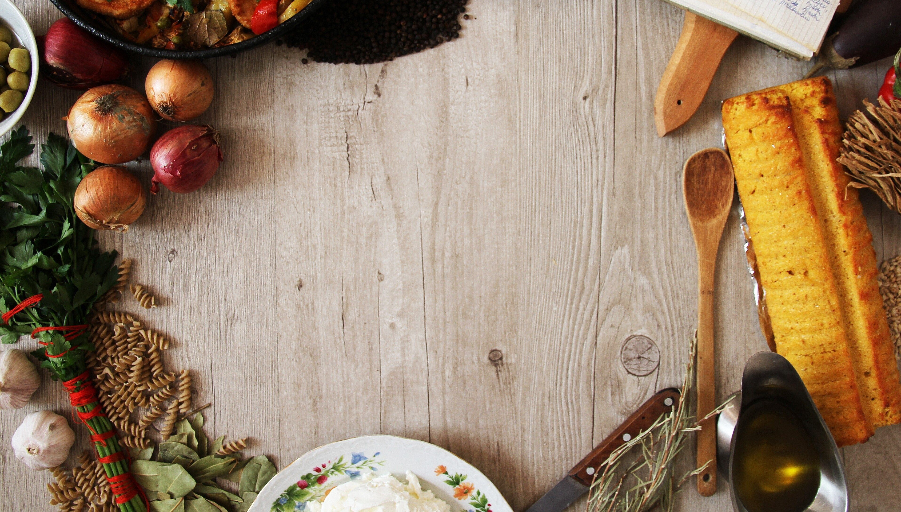
SUPPER | SUNDAY | MONDAY | TUESDAY | WEDNESDAY | THURSDAY | FRIDAY | SATURDAY
MAIN 1 | ‘Sunday Roast’ Loin of Pork, Seasoning, Apple Sauce | Deep Fried Whitby Scampi ‘Homemade’ Tartare Sauce | Honey Glazed Bacon Steaks, Grilled Pineapple | Spiced Quorn Vegetable Fajitas (V) | Buffalo Chicken and Blue Cheese Slaw | Cheese & Onion Tarts, Pesto Dressing (V) | ‘Kebab Nite’ Homemade Doner Kebabs served in Flatbreads
MAIN 2 | Roasted Carrot, Whipped Feta Cheese Tart (V) | Portabella Mushroom Cheeseburger (V) | Sweetcorn, Spring Onion, Cheese, Fritters (V) | Spiced Turkey Fajitas | Spiced Cauliflower Salad (V) | Slow Cooked Braised Steak, Caramelised Onions in a Rich Gravy | Spiced Tofu Vegetable Kebabs served in Flatbreads (V)
SIDE | Roast & Creamed Potatoes, Cauliflower Cheese, Carrots, Pork Gravy | Skin on Fries, Minted Crushed Peas, Crispy Onions Bacon Bits | Daulphionise Potatoes, Green Beans | Mexican Rice, Salsa, Soured Cream, Tortilla Chips, Grated Cheese, Assorted Salads | Spiced Panko Potato Wedges, Beetroot, Feta Pomegranate Salad | Baby Roast Potatoes, Honey Roasted Carrots and Parsnips | Lemon and Thyme Greek Style Potatoes, Greek Salad, Tzatziki
SALAD BAR | N/A | Salad of The Evening
DESSERT | Treacle Tart , Whipped Cream | Mandarin and Raspberry Sponge, Custard | Lemon and Elderflower Tray bake | Chocolate Mousse | Raspberry Brownie served with Vanilla Cream | Croissant Bread and Butter Pudding | Homemade Jam Doughnuts
FRUIT & POTS | N/A | Fresh Fruit Salad, Fruit Basket
HYDRATION | Chilled Milk, Selection of Juices, Tea, Hot Chocolate, Coffee selection
08-14.09.24

